Slide 1
Return to the Office

Slide 2
Tentative Return Date
As the local public health situation improves and restrictions are lifted, the University is looking forward to beginning a phased approach to welcoming members of the community back to campus to resume in-person academic and work activities.
September 15

Slide 3
Before we go back…
A testing exercise needs to be completed (checklist of onboarding items will be provided)
1-2 individuals in the office per day

Slide 4
Hybrid work model
Monday, Tuesday, Thursday, Friday: Work from home
Wednesday: All team members on-site (please try to avoid scheduling doctor’s appointments on this day)
Will be sharing space with HIS and Revenue Cycle/Patient Reg
Assigned seating on Wednesday is preferred but we can discuss
When on-site, staff members will need to:
  Bring laptop in and dock into station
  Complete Crimson Clear (TBD)
  Personal lockers will be available in breakroom but a combination lock will be needed
All employees with any on-campus presence
  Vaccinated – every other week
  Unvaccinated – once per week
For fully vaccinated persons, physical distancing is not required anywhere on campus when masked, starting July 15 (includes HUHS). Unvaccinated persons must still maintain 6’ distancing wherever possible.
Masks are still required for everyone at all times in HUHS spaces (unless alone in a private office). This includes us when on phones.
In-person meetings are allowed with no capacity limit aside from fire code. Meeting organizers should offer a zoom link if possible to allow participation by those who are remote. Please allow sufficient space in case anyone wishes or needs to stay 6 feet away from others.
Unmasking and eating is allowed in designated break rooms (or alone in private offices), but distancing must be maintained if you know yourself to be unvaccinated.
For now, we are discouraging the sharing of food at indoor meetings at HUHS. Food should be avoided for indoor celebrations unless individually wrapped so that folks may take away and consume elsewhere.

Slide 5
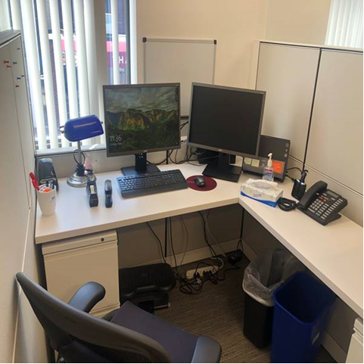
My Desk
Each space is equipped with
Dual monitor
Desk lamp
Pen holder
Stapler
Tape
Phone set
Headset holder (individual headset will likely be stored in locker on-site)
Scanner
Dymo labelmaker
Mouse
Keyboard
Tissues
Sanitizer
Disinfectant wipes (not shown here)
Checklist of how to clean up space at end of day (not shown here)
Foot rest stored underneath desk
File storage TBD
Whiteboard TBD
Laptop docking station
Camera (due to privacy concerns, cameras will only be placed in private offices/conference room. Staff will be able to book private room if needed for a zoom meeting).
Assigned vs first come first served???

Slide 6
Our Office
Mail will need to be picked up and distributed each Wednesday and a rotation should be established
Fax machine, printers, copier etc. are all useable
Member Services will have one big file cabinet by the back door of the old Pharmacy space
Clean up space at end of each day, disposing of trash and wiping down area. There is a good chance your desk area will be used by another team.
Conference Room is available (but looks more like a smaller office)
Signage is being created and will be displayed; all health plan signage has been removed.
Front Desk will not be staffed by any department
Postcards have been created to handout to clinical teams informing patients of how to contact us.
Virtual Assistant option through Zoom is being looked into but likely won’t come with a Phase 1 rollout
DIS TBD

Slide 7
Phones
Contact Center TBD
  Should use web client
    Option 1: Use desk phone as remote number, but make sure to not check the “Use this station automatically the next time I log on” box.
    Option 2: Use cell phone as remote number.
    Option 3: Use Jabber client, use audio through computer/headphones with microphone. Requires double pickup.
Personal Phones TBD
    Use Jabber Client and answer phone through computer audio.
    If desk phone is the same as your personal line, answer phone through desk set.

Slide 8
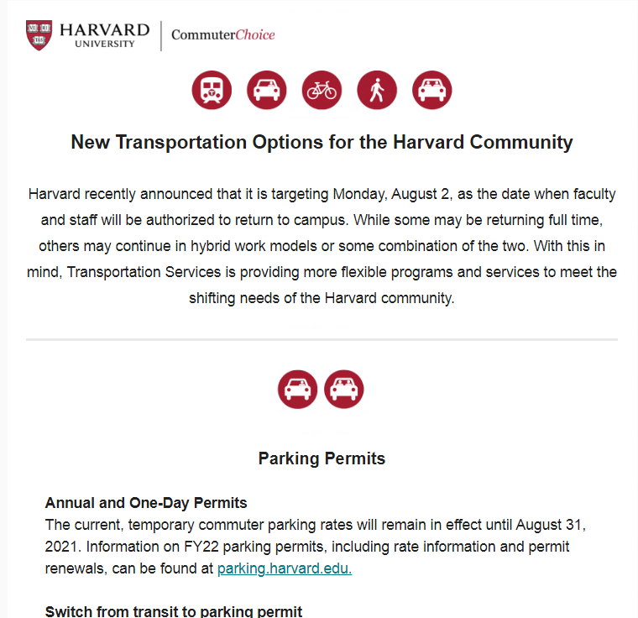
Commuter Options refer to email from May 25, 2021

Slide 9
Questions from staff
Dress Code?
Laptop bags?
Is there any equipment/cables we need to bring in with the laptop?

